Slide 1
Functions in C

Slide 2
Functions in C
Definition: A function is an independent module that performs a specific task.
It is also defined as,
A function is a self-contained group of statements that performs a specific task.
Example: Function sqrt() computes square root of a given number.

Slide 3
Types of functions
Functions
Built-in/Library
Functions
User Defined Functions
C provides a rich collections of library functions whose definitions have been written and are ready to be used in our programs. The implementation details of these functions are not known to the users.
Example
User defined functions are those functions that are defined by the user. Assume you want to compute square of a given number, So we can write a function known as square(), main(), and many more.
Math Library functions such as,
sqrt(), pow() defined in <math.h>
Standard IO Library functions such as, printf(), scanf() defined in <stdio.h>
String Library functions such as,
strlen(), strrev() defined in <string.h>

Slide 4



Elements of user defined functions
A programmer when writes any user defined functions he should be providing details these three elements of user defined functions namely,
Function declaration / Function prototype
Function call
Function definition

Slide 5
Function declaration / Function prototype
Like variables, all functions should be declared, before they are invoked.
A function declaration tells the compiler about a function's name, return type, and parameters.
Function declaration are placed in the global declaration section before main(). However we can also declare a function inside the main().
Function declaration is not required if a function is defined before it is called
Syntax:
return_type function_name (parameter list);
Examples:
1. void display();
2. int area_rectangle();
3. int sum(int a, int b);
4. void circle_area(int radius);
Each parameter must be declared separately with their type.
Example: int a , int b
int a, b → is wrong

Slide 6
Function definition
Function definition contains the actual implementation code/logic for a function to achieve a specific task.
Parameters present in the function definition are known as formal parameters. These parameters will receive a copy of values from actual parameter present in the function calls.
Sometimes, function definition may not have parameters.
Syntax:
return_type function_name (formal parameter list)
{
local declarations
statement or set of statements
return statement(if non void)
}
Example:
int square(int n)
{
int res;
res=n*n;
return res;
}

Slide 7
Function call
Invoking a function from the main () is done through function call.
Here, we call the function to get the task done.
Function call consists of actual parameters that are passed to the formal parameters of the function definition.
Syntax:
function_name (actual parameter list);
Example:
square(n);
sum();
area(length ,breadth);
isprime(n);

Slide 8
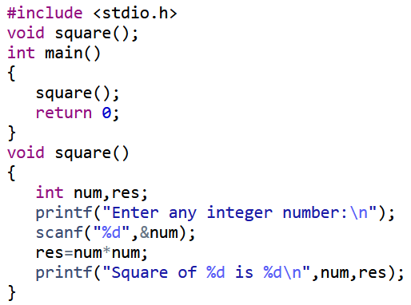
Example showing the three elements of user defined functions
Function declaration
Function call
Function definition

Slide 9
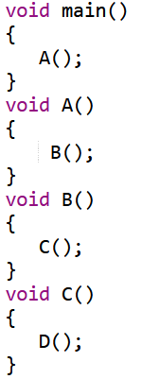
Calling functions and called functions
Find the number of calling functions and called functions.
Number of Calling functions : ?
Number of Called functions : ?

Slide 10
Return Values and Their Types
A function may or may not send back any value to the calling function.
If it does, it is done through the return statement.
While it is possible to pass any number of values to the called function, the called function can only return a maximum of one value per call.
The return statement can take one of the following forms:
return; // Does not return any value
return(expression); ex- return n*n;

Slide 11
Terminology
Formal Parameter : A variable and its type as they appear in the prototype of the function or method.
Actual Parameter : The variable or expression corresponding to a formal parameter that appears in the function or method call in the calling environment.

Slide 12
Passing Parameters in Functions
When a function is called, the calling function has to pass some values to the called functions.
There are two ways by which we can pass the parameters to the functions:
1. Call by value
Here the values of the variables are passed by the calling function to the called function.
Any modifications to the formal parameter variable inside the called function or method will not be reflected in the actual parameter in the calling environment
This happens as all the changes are made on the copy of the variables and not on the actual ones.

Slide 13
Points on Call by Value
When arguments are passed by value, the called function creates new variables of the same data type as the arguments passed to it
The values of the arguments passed by the function are copied into the newly created variables
Values of the variables in the calling functions remain unaffected when the arguments are passed using call by value

Slide 14
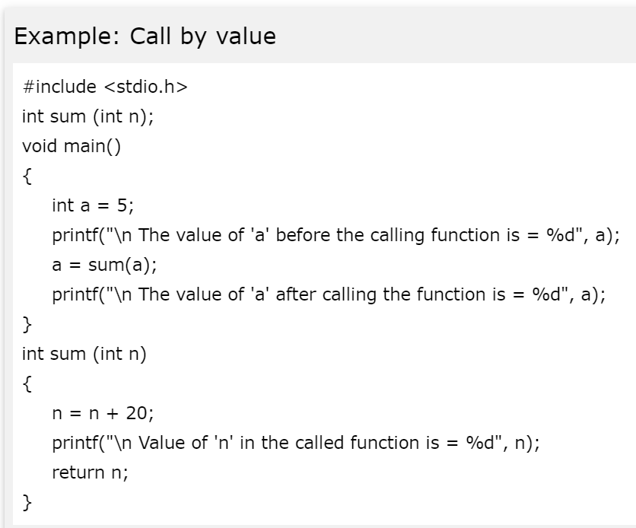
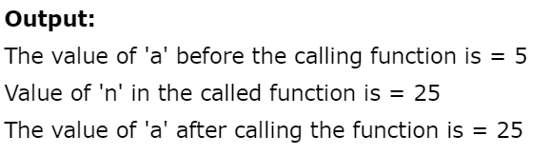

Slide 15
2. Call by reference
Here, the address of the variables are passed by the calling function to the called function.
The address which is used inside the function is used to access the actual argument used in the call.
If there are any changes made in the parameters, they affect the passed argument.
For passing a value to the reference, the argument pointers are passed to the functions just like any other value.

Slide 16
To indicate that an argument is passed using call by reference, an ampersand sign(&) is placed after the type in the parameter list
In the call by reference, a function receives a reference/address to the argument rather than a copy of its value
Hence, when the function modifies the value of the variable and that change will be reflected in the calling function as well

Slide 17
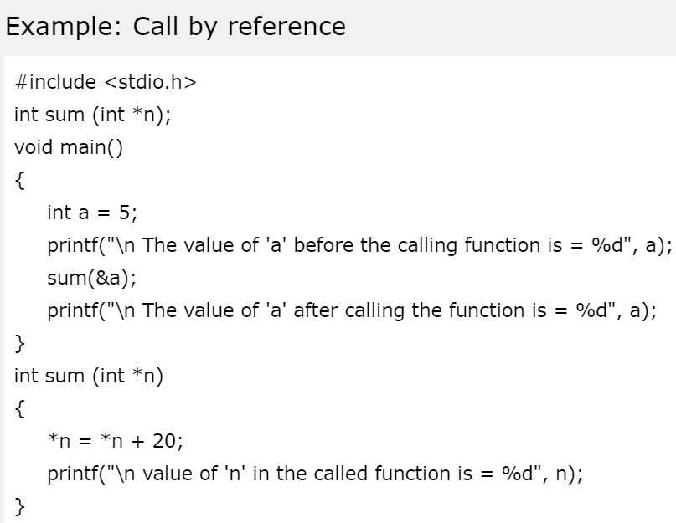
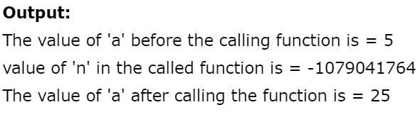

Slide 18




Categories of user defined functions
Functions either return a value or they may not. Functions that don’t return a value are known as void functions.
Some functions may have parameters and some may not.
Combining return types and parameters result in four different categories of user defined functions as given below
void functions don’t return any value to the calling function.
Non-void functions return one value per call.
Non void meaning other than void like int, float, double, char etc,.
void functions without parameters
void functions with parameters
Non-void functions without parameters
Non-Void functions with parameters

Slide 19
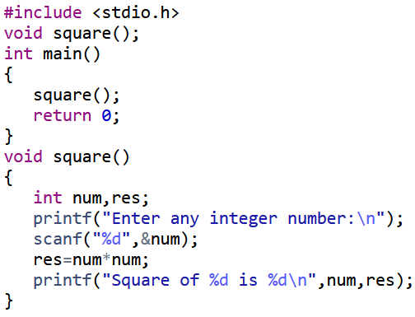
void functions without parameters
In this category there is no data transfer from calling function to the called function and called function to calling function. Only control is transferred from calling function to called function and back from called to calling function. Also known as function without arguments and without return value.

Slide 20

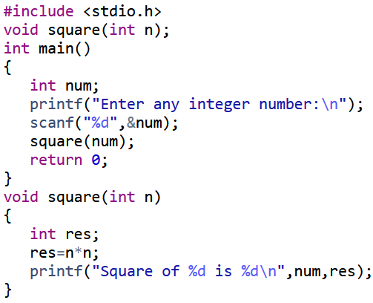
void functions with parameters
In this category there is data transfer between the calling function to the called function using parameters. But there is no data transfer from called function to calling function. This is an example for pass by value. Also known as function with arguments and without return value.
n=num
num is copied to n
num

Slide 21
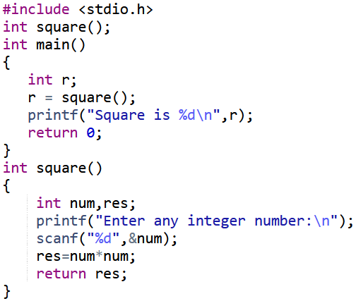
Non-void functions without parameters
In this category there is no data transfer between the calling function to the called function. But data is transferred from called function to calling function through return statement. Also known as function without arguments and with return value
res

Slide 22
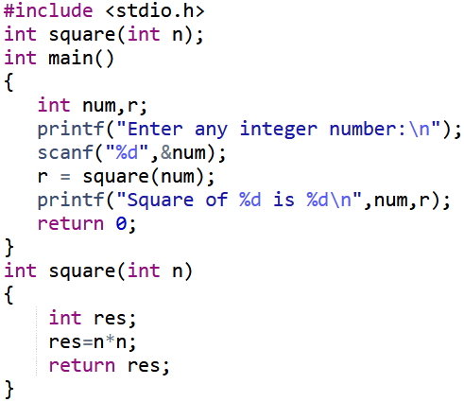
Non-void functions with parameters
In this category there is data transfer between the calling function to the called function and called function to calling function along with the transfer of control. Also known function with arguments and with return values. This is also an example for pass by value.
num
n=num
num is copied to n
res

Slide 23
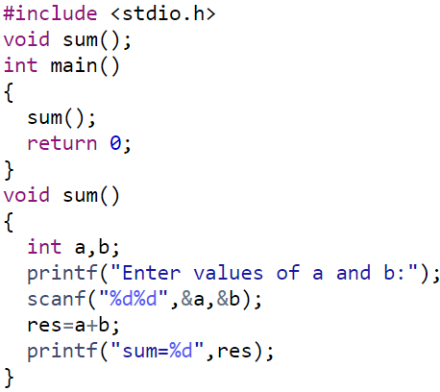
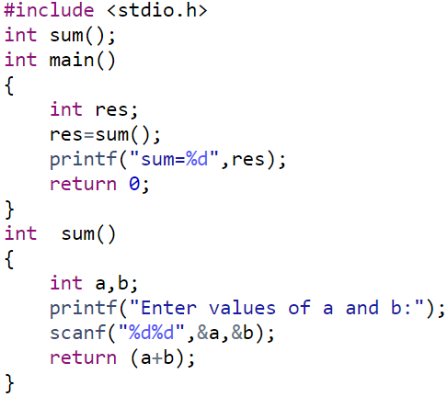
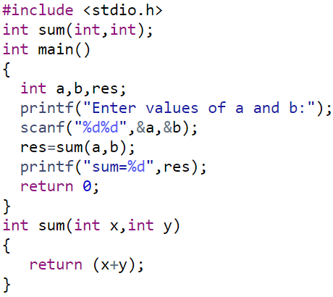
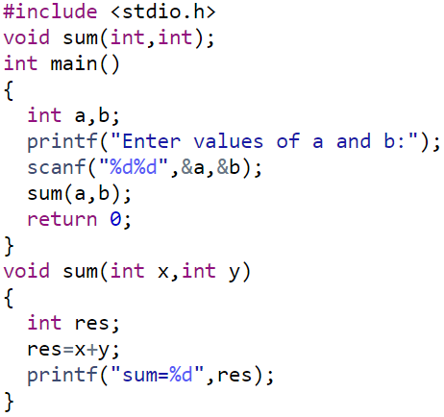
Arguments: no
Return value: yes
Arguments: no
Return values: no
Arguments: yes
Return value: no
Arguments: yes
Return value: yes

Slide 24
Identify the category of the below given function declaration/function prototype of the user defined functions
int sum(int a, int b);
int rectangle_area();
float simple_interest(int p, int t, int r);
void factorial();
int isprime(int n);
void largest(int a,int b);

Slide 25
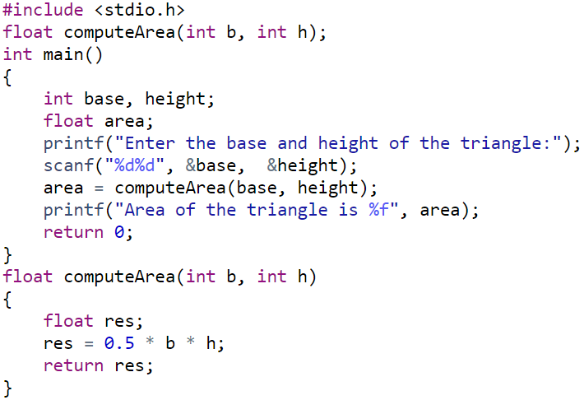
Write a function computeArea(int, int) that returns the computed area of a triangle for the given base and height. Write a C program that invokes this function to find the area of triangle.

Slide 26
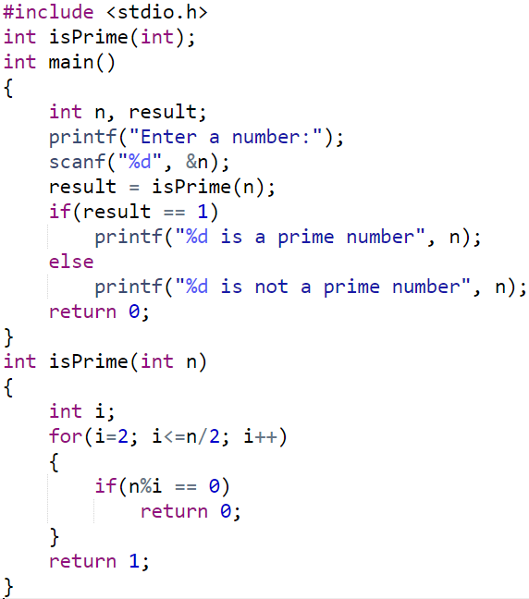
Design and develop a C function isPrime(num) that accepts an integer argument and returns 1 if the argument is prime, a 0 otherwise. Write a C program that invokes this function to check whether a given number is prime or not.

Slide 27
Advantages of using functions
Avoid repetition of codes.
Increases program readability.
Divide a complex problem into simpler ones.
Reduces chances of error.
Modifying a program becomes easier by using function.
Drawback:
Function calls involve transfer of control from calling function to called function and back, making the program execution slow!

Slide 28
Scope of Variables
All constants and variables have a defined scope(visibility and accessibility)
Scope in any programming is a region of the program where a defined variable can have its existence and beyond that variable can not be accessed.
There are three places where variables can be declared in C programming language:
Inside a function or a block which is called local variables.
Outside of all functions which is called global variables.
In the definition of function parameters which is called formal parameters.

Slide 29
There are 4 types of scope in C
Block Scope
A Block in C is a set of statements written within the right and left braces({ }). A block may contain more blocks within it, i.e., nested blocks.
A variable declared within a Block has a Block Scope.
This variable is accessible anywhere within the block and its inner blocks.
Hence, the scope of such a variable ends where the block ends.

Slide 30
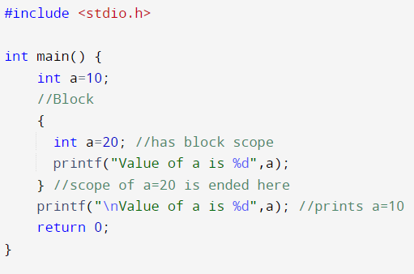
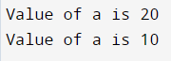
Output

Slide 31
Function Scope
Function scope begins at the opening of the function and ends with the closing of it.
Function scope is applicable to goto label names only.
A label declared is used as a target to goto statement and both goto and label statement must be in same function
Ex: int main()
{
….
loop: //goto label has function scope
….
goto loop; // the goto statement
….
return 0;
}

Slide 32
Program Scope
Global variables declared outside the function bodies have a program scope.
The availability of global variables stays for the entire program after its declaration.
If global variables are not initialized during its initialization then it is automatically initialized to zero by the compiler .
Example
The following example shows two global variables, a and b. As seen in the code below, these variables are accessible by both the test function and the main function:

Slide 33
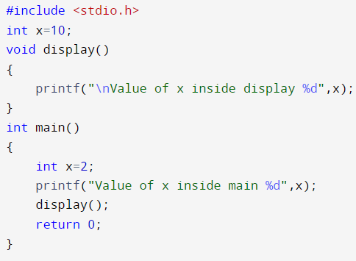
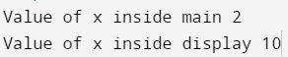
Output

Slide 34
File Scope
When a global variable is accessible until the end of the file, the variable is said to have file scope
To allow variable to have file scope, declare the variable with the static keyword
Ex:
static int x=10;
A global static variable can be used anywhere from the file in which it is declared but it is not accessible by any other files

Slide 35
ARRAYS

Slide 36
Arrays An array is collection of elements of similar data type stored in contiguous memory location.
Why Arrays????
Arrays are used when there is a need to use many variables of the same type. Say you want to store marks scored by 60 students of our class in C programming subject, so how many variables you need to declare to hold 60 values? 60 variables? Will it be feasible? So use an array for the same task instead. The programmer has to just specify the data type of elements and the number of elements that are required as the size of the array.
60 variable’s declaration???
int s1,s2,s3,……..s60;
Or
int s[60] ;
Which is easy???

Slide 37
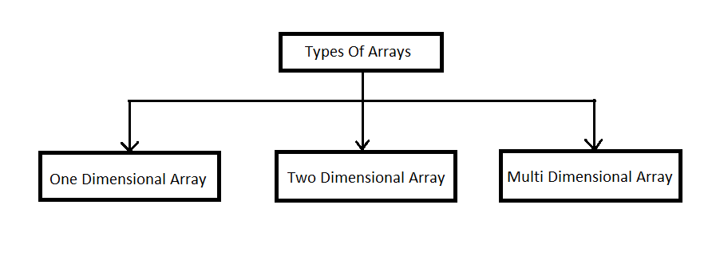
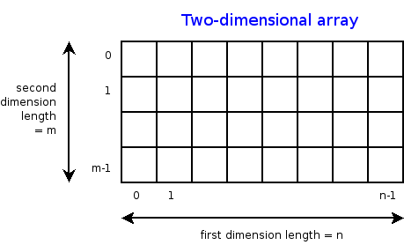
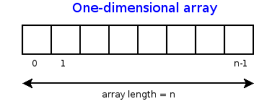
int a[5];
int a[5][5];
int a[5][5][5];

Slide 38
One Dimensional Array (1D Array)
Syntax for Declaring 1D Array
data_type array_name[size];
Example for Declaring 1D Array
int a[5];
Address of the array, in a contiguous manner
1000
1004
1008
1012
1016
a
Name of the
array
a[0]
a[1]
a[2]
a[3]
a[4]
Subscript or index, used to access the specific value from an array, a[3] gives 40

Slide 39
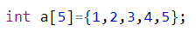
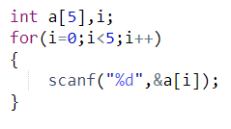
Initializing/Storing 1D Array
1. Compile Time Initialization
Types of compile time array initialization:
Complete array Initialization
Partial array Initialization
Initialization without size
Initialization with Zero
2. Runtime Initialization

Slide 40
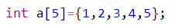
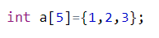
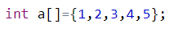
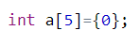
Compile Time Array Initializations
1. Complete array Initialization
2. Partial Array Initialization
1 | 2 | 3 | 4 | 5
1 | 2 | 3 | 0 | 0
a[0]
a[1]
a[2]
a[3]
a[4]
a[0]
a[1]
a[2]
a[3]
a[4]
3. Initialization without size
4. Initialization with Zero
1 | 2 | 3 | 4 | 5
0 | 0 | 0 | 0 | 0
a[0]
a[1]
a[2]
a[3]
a[4]
a[0]
a[1]
a[2]
a[3]
a[4]

Slide 41
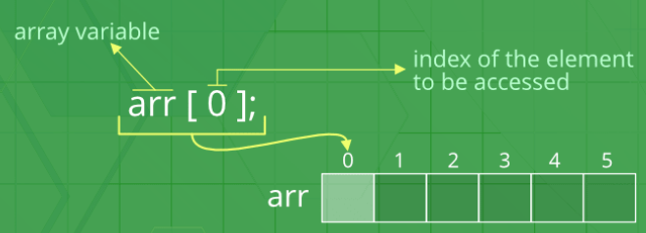
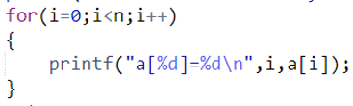
Accessing Array Elements
Array elements are accessed by using an integer index. Array index starts with 0 and goes till the size-1.
The name of the array is also a pointer to the first element of the array.
It can also be accessed using for loop

Slide 42
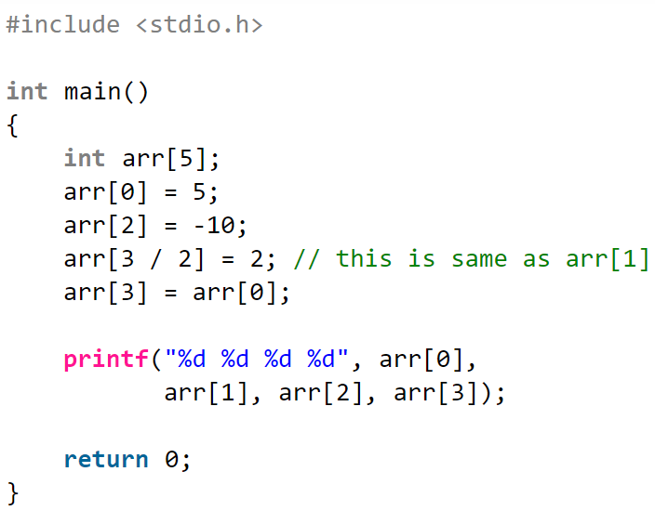
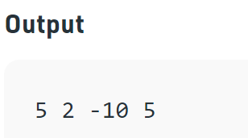

Slide 43
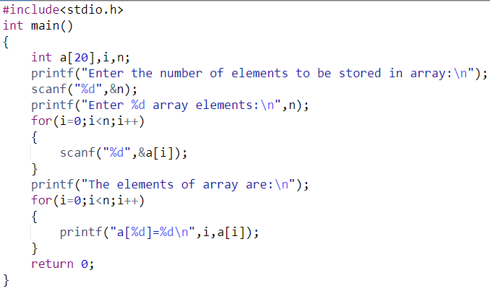
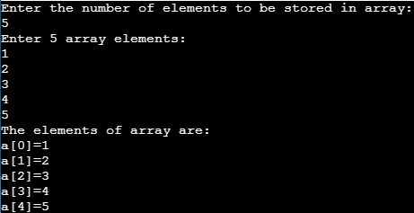
Write a C Program to scan and print n array elements.

Slide 44
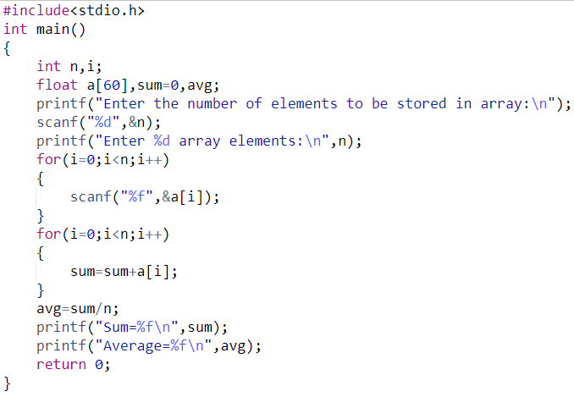
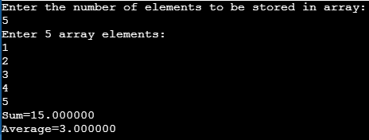
Write a C Program to scan n elements in an array and find the sum and average of all the elements of the array & print the same

Slide 45
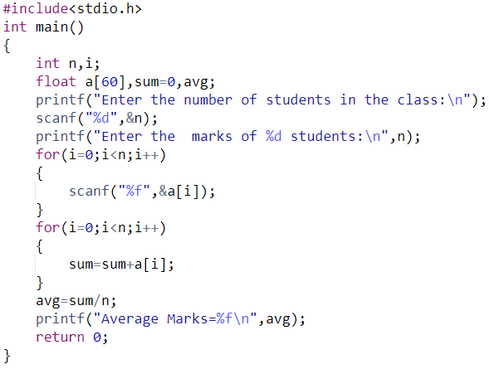
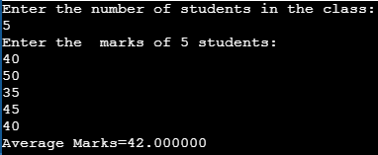
Write a C program to read marks scored by each student in C programming subject in first internal exam, and calculate the average.

Slide 46
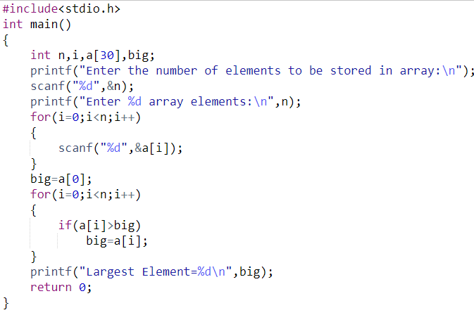
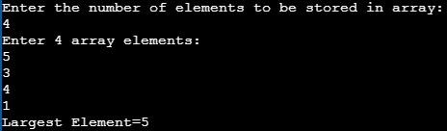
Write a C program to find the largest element in an array of n elements

Slide 47
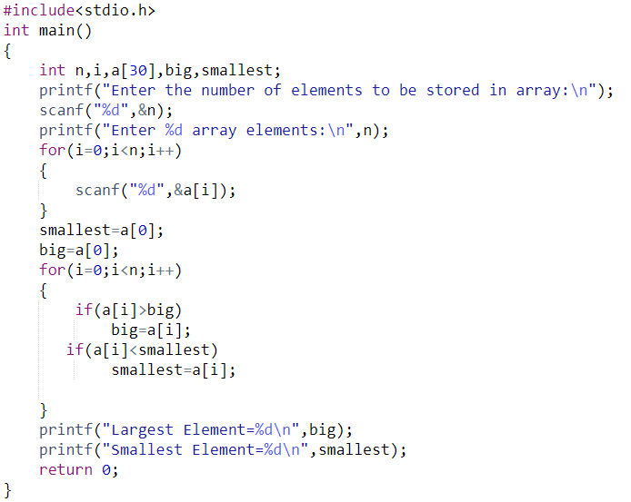
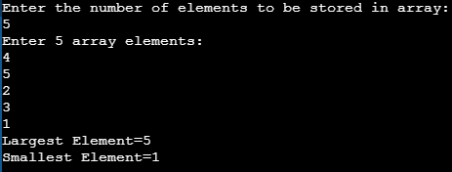
Write a C program to find the largest and smallest element in an array of n elements

Slide 48
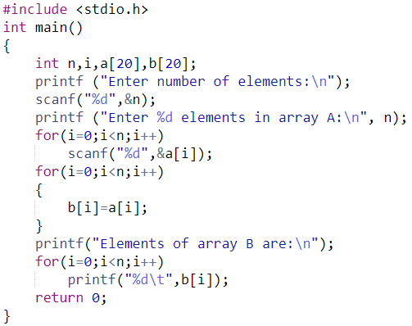
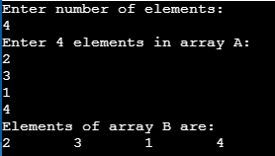
Write a C Program to copy the elements of one array to another array.

Slide 49
Write a C Program to perform element wise addition of two arrays a and b in C.
1 | 2 | 3 | 4 | 5
c[0] = a[0]+b[0]
c[1] = a[1]+b[1]
c[2] = a[2]+b[2]
c[3] = a[3]+b[3]
c[4] = a[4]+b[4]
In general,
c[i] = a[i] + b[i]
Where i=0 to n-1
a[0]
a[1]
a[2]
a[3]
a[4]
6 | 7 | 8 | 9 | 10
b[0]
b[1]
b[2]
b[3]
b[4]
7 | 9 | 11 | 13 | 15
c[0]
c[1]
c[2]
c[3]
c[4]

Slide 50
Applications / Operations on 1D Arrays

Slide 51

1. Searching Techniques
Searching is an operation or a technique that helps to find a given element or a value in the list of values. Any search is said to be successful or unsuccessful depending upon whether the element that is being searched is found or not.
Types of Searching Techniques
Linear Search
Binary Search

Slide 52
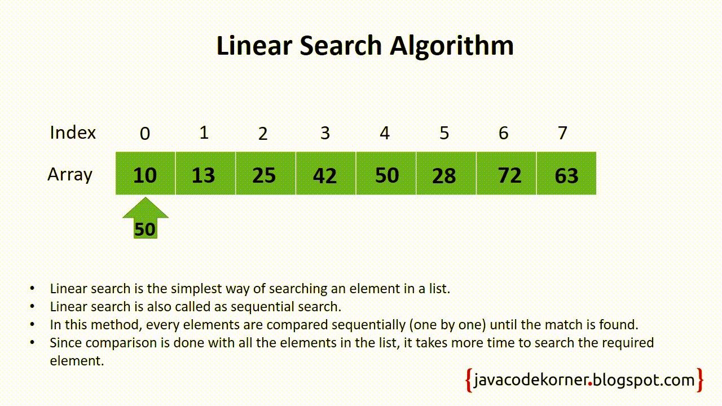
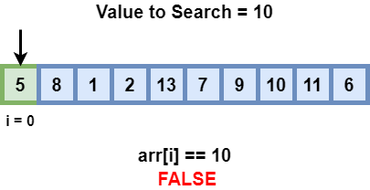

Slide 53
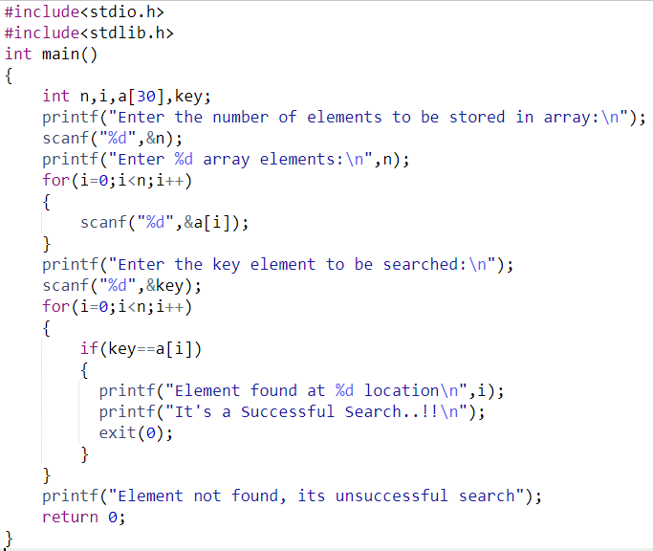
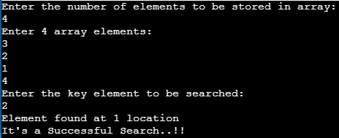
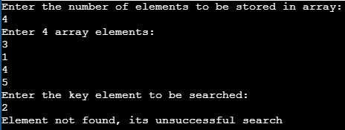
Write a C program to scan n array elements and perform linear search for a given key element

Slide 54

Binary Search

Slide 55



Write a C program to scan n array elements and perform Binary search for a given key element

Slide 56

Comparing Binary Search and Linear Search

Slide 57

2. Sorting Techniques
Sorting is the process of arranging the elements either in ascending (or) descending order.
Types of Sorting Techniques
Bubble Sort
Selection Sort

Slide 58

Bubble Sort
In Bubble sort, each element is compared with its adjacent element. If the first element is bigger than the second one, then the positions of the elements are interchanged. Otherwise it is not changed.
Then the next element is compared with its adjacent element and the same process is repeated for all the elements in the array until we get a sorted array.

Slide 59


Write a C Program to read n arrays elements and sort the elements of the array using Bubble sort technique

Slide 60

3. Copying Array Elements
Copying array elements to another array will yield an array of the same length and elements as the original one

Slide 61



Slide 63
There are situations where we need to store a table of values.
For example,
Newspaper sales of 5 different newspapers in the twelve month period.
int sales[5][12]
Rainfall statistics of last 10 years
in each month.
int rain_stats[10][12];
Stock prices of best 50 stock in last one decade.
int stock_prices[50][10];
Number of Admissions in each department in our college in last 5 years.
int admissions[10][5];
Why 2D arrays???
One-dimensional array may be represented as a list.
int ccp_marks[60]; → to store marks of 60 students in C programming subject.
How about storing marks of 60 students in 6 different subjects??
int ccp_marks[60],
int chem_marks[60] ,
int ele_marks[60] and so on.
Instead use one 2D array.
int marks[60][6];
or
int marks[6][60];

Slide 64


Showing how a 2D is represented in the form of table/matrix
int stock_prices[5][6];
Memory representation of a 2D array

Slide 65

What is Two Dimensional Array???
A two dimensional array can be defined as an array of arrays. The 2D array is organized as matrices which can be represented as table of rows and columns.
A 2-D array may be represented as a matrix.
Each element of the matrix is accessible through a pair of subscripts i and j where i ranges from 0 to ROWSIZE – 1 and j ranges from 0 to COLSIZE – 1.
Second element of first row is at subscript [0][1]
Third element of third row is at subscript [2][2]

Slide 66

How to declare a 2D array?
ROWSIZE and COLSIZE must be integer constants
Syntax:
data_type array_name[size1][size2];
With this declaration around 20 i.e. 4*5 memory locations of type integer are reserved. Altogether around 80 bytes of memory(considering integer size as 4bytes)
Example:
int a[4][5];
No of rows
No of Columns

Slide 67
Initialization of 2-D arrays
Like one-dimensional arrays, two-dimensional arrays can also be initialized following their declaration.
int a[2][3] = {2, 3, 7, 6, 8, 12};
int a[2][3] = { {0, 0, 0}, {1, 1, 1} };
If values are missing in initializer, they are automatically set to zero.
When the array is completely initialized with all values, we need not specify the first dimension.
int a[ ][3] = { {0, 0, 0}, {1, 1, 1} };
Following will initialize all the elements to zero.
int a[3][3] = {0, 0, 0, 0, 0, 0, 0, 0, 0};
If we want to initialize all the elements to zero, the following shortcut method can be used:
int a[3][3] = { {0}, {0}, {0} };

Slide 68

How to initialize a 2D array?
Syntax:
datatype arrayname[size1][size2]={value1, value2….value n}
Compile time initialization
1. int a[3][3]={1,2,3,4,5,6,7,8,9};
Or
2. int a[3][3]={ {1,2,3},
{4,5,6},
{7,8,9} };
Run time initialization

Slide 69

Write a C program to store and print marks of 10 students in 5 different subjects using a two dimensional array.
Scanning a 2D array
Printing a 2D array

Slide 70



Printing a 2D array
in matrix form

Slide 71


Write a program to read m rows and n columns in a 2D array(matrix) and display the sum of all the elements of the matrix.

Slide 72

Write a C program to read two matrices, add them and display the resultant matrix.
What is the Condition to add two matrices?
They should be of same order
m===p and n==q

Slide 73


Slide 74



Slide 75

Write a C program to read two matrices, multiply them and display the resultant matrix.
What is the Condition to multiply two matrix?
Consider two Matrices, Matrix A(m*n) and Matrix B(p*q).
Number of columns of matrix A should be equal to number of rows of matrix
B i.e. n==p
Each row of matrix A is taken and multiplied with all the columns of matrix B
So if there are m rows then those m rows are multiplied with q columns.
Therefore the resultant matrix will be of order m*q

Slide 76


Slide 77


Slide 78

Write a program to add the elements on the principal or main or major diagonal elements of a square matrix.
0 1 2
0
1
2
Sum of Minor diagonal elements
0,0
1,1
Sum of Principal or Major diagonal elements
2,2
Check if the matrix is a square matrix. i.e. row and column should be same. m == n
Add only principal diagonal elements.
How to find it?
When i==j perform addition.

Slide 79



Slide 80


Write a program to transpose a matrix.
The transpose of a matrix is a new matrix that is obtained by exchanging the rows and columns.

Slide 81


Slide 82



Output 1
Output 2

Slide 83
Programs on 2D arrays
1. Write a C Program to store the marks of 10 students in 5 different subjects using a 2D array. Find the highest and lowest marks in each subject scored by the students also compute the average marks of the subject. Print all the computed results appropriately.

Slide 84

Passing 1D Arrays to Functions
In C, when we pass an array to a function say fun(), it is always treated as a pointer by fun(). The below example demonstrates the same.

Slide 85
Consider the following syntax to pass an array to the function.
functionname(arrayname);//passing array
Methods to declare a function that receives an array as an argument
There are 3 ways to declare the function which is intended to receive an array as an argument.
First way:
Syntax:
return_type function(type arrayname[])
Second way:
Syntax:
return_type function(type arrayname[SIZE])
Third way:
Syntax:
return_type function(type *arrayname)

Slide 86


Here, we have passed array parameters to the display() function in the same way we pass variables to a function.

Slide 87

C function to Sort the Array

Slide 88


Slide 89



Slide 90
Passing 2D Arrays to Functions
To pass multidimensional arrays to a function, only the name of the array is passed to the function (similar to one-dimensional arrays).
Syntax:
return_type function(type arrayname[row][column])

Slide 91



Slide 92
Storage Classes in C

Slide 93
Storage Classes in C
Definition: Storage classes in C are used to determine the lifetime, visibility, memory location, and initial value of a variable.
There are four types of storage classes in C
Automatic
External
Static
Register

Slide 94

Types of Storage Classes

Slide 95
Automatic
Automatic variables are allocated memory automatically at runtime.
The visibility of the automatic variables is limited to the block in which they are defined.
The scope of the automatic variables is limited to the block in which they are defined. The automatic variables are initialized to garbage by default.
The memory assigned to automatic variables gets freed upon exiting from the block.
The keyword used for defining automatic variables is auto.
Every local variable is automatic in C by default.

Slide 96


Example

Slide 97


Example

Slide 98
Static
The variables defined as static specifier can hold their value between the multiple function calls.
Static local variables are visible only to the function or the block in which they are defined.
A same static variable can be declared many times but can be assigned at only one time.
Default initial value of the static integral variable is 0 otherwise null.
The visibility of the static global variable is limited to the file in which it has declared.
The keyword used to define static variable is static.

Slide 99


Example

Slide 100
Register
The variables defined as the register is allocated the memory into the CPU registers depending upon the size of the memory remaining in the CPU.
We can not use &operator for the register variable.
The access time of the register variables is faster than the automatic variables.
The initial default value of the register local variables is 0.
The register keyword is used for the variable which should be stored in the CPU register. However, it is compiler’s choice whether or not; the variables can be stored in the register.

Slide 101


Example

Slide 102


Example

Slide 103
Extern
The external storage class is used to tell the compiler that the variable defined as extern is declared with an external linkage elsewhere in the program.
The variables declared as extern are not allocated any memory. It is only declaration and intended to specify that the variable is declared elsewhere in the program.
The default initial value of external integral type is 0 otherwise null.
We can only initialize the extern variable globally, i.e., we can not initialize the external variable within any block or method.
An external variable can be declared many times but can be initialized at only once.
If a variable is declared as external then the compiler searches for that variable to be initialized somewhere in the program which may be extern or static. If it is not, then the compiler will show an error.

Slide 104


Example

Slide 105


Example

Slide 106


Example

Slide 107


Example

Slide 108


Example
OUTPUT

Slide 109
Recursion in C

Slide 110
Recursion in C
Definition: A function that calls itself is known as a recursive function. And, this technique is known as recursion.
Recursive Function:
A recursive function performs the tasks by dividing it into the subtasks. There is a termination condition defined in the function which is satisfied by some specific subtask. After this, the recursion stops and the final result is returned from the function.

Slide 111
Recursive Function
The case at which the function doesn't recur is called the base case whereas the instances where the function keeps calling itself to perform a subtask, is called the recursive case.

Slide 112

Recursive function
Recursive call/case
Recursive call/case
Base call/case
Base call/case

Slide 113

How does it work?

Slide 114


Write a C program to calculate the factorial of a number using recursion
OUTPUT:

Slide 115


Working

Slide 116


Write a C program to find the nth term of the Fibonacci series.
OUTPUT:

Slide 117
Fibonacci series using Recursion
int fib(int num)
{
if (num==1)
return 0;
else if (num==2 || num==3)
return 1;
else return(fib(num-1)+fib(num-2));
}
int main()
{
int limit,i;
printf(“Enter the limit”);
scanf(“%d”,&limit);
for(i=1;i<=limit;i++)
{
printf(“\n%d\n”, fib(i));
}
}

